Slide 1


Improving Employee Retention by Predicting Employee Attrition Using Machine Learning
Created by:
Muhammad Cikal Merdeka
Email : mcikalmerdeka@gmail.com
LinkedIn : linkedin.com/in/mcikalmerdeka
Github : github.com/mcikalmerdeka
Dedicated entry-level data scientist with analytical and experimental background of Physics. My graduation 2023, a pivotal year marked by significant advancements in artificial intelligence with the introduction of GPT-4 and other generative AI models, has fueled my curiosity and excitement to delve into the field of data. I have comprehensive grasp of data science methodology from business understanding to modelling process with proficiency in Python, SQL, Tableau, Power BI, Looker Studio and other tools related to data analytics workflow from several coursework and bootcamps.

Slide 2
Project Overview
Employee attrition poses a significant challenge to organizations, leading to substantial costs associated with hiring, training, and lost productivity. High turnover rates can disrupt business operations, lower morale, and decrease organizational efficiency. Traditional methods of predicting and mitigating employee turnover often rely on retrospective analyses and generalized strategies that fail to address individual employee needs and circumstances.
This project aims to develop a machine learning model to predict employee attrition accurately and provide actionable insights to improve employee retention strategies. By leveraging historical employee data, the model will identify patterns and factors contributing to employee turnover, enabling HR departments to implement proactive measures to retain valuable talent.
For more details, you can view the Jupyter notebook here.

Slide 3
Dataset Overview
The original dataframe has 287 rows and 25 columns. The columns of our dataset are :
Username : Username of the employee account
EnterpriseID : ID of the employee in the company
StatusPernikahan : Marital status of the employee
JenisKelamin : Gender of the employee
StatusKepegawaian : Employment status of the employee
Pekerjaan : Role of the employee
JenjangKarir : Level of experience of the employee
PerformancePegawai : Employee performance category score
AsalDaerah : Employee region of origin
HiringPlatform : Platform the employee application is accepted
SkorSurveyEngagement : Level of employee engagement within the organization
SkorKepuasanPegawai : Level of how satisfied employees are with their job and the workplace
JumlahKeikutsertaanProjek : Number of times the employee join a project
JumlahKeterlambatanSebulanTerakhir : Number of times the employee is late
JumlahKetidakhadiran : Number of times the employee is absent
NomorHP : Handphone number of the employee
Email : Personal email of the employee
TingkatPendidikan : Education level Handphone number of the employee
PernahBekerja : Whether the employee have previous work experience or not
IkutProgramLOP : Whether the employee join LOP Program or not
AlasanResign : Reason for resignation of the employee
TanggalLahir : Birth date of the employee
TanggalHiring : Hiring date of the employee
TanggalPenilaianKaryawan : Scoring date of the employee
TanggalResign : Resignation date of the employee

Slide 4
Data Cleaning & Preprocessing
Drop Unnecessary Columns and Handling Inconsistent Values Format
PernahBekerja and IkutProgramLOP columns in the dataset is initially dropped because they don't provide valuable information for analysis or modeling process.
Values in some columns are renamed maintain format similarity for the entire dataframe and also add more information/context to them. The values will be in the format of title case (ex : Data Analyst). Columns that have their values renamed are : (column name - example of their original values format)
StatusPernikahan - Belum_menikah
StatusKepegawaian - FullTime
JenjangKarir - Senior_level
PerformancePegawai - Sangat_bagus
HiringPlatform - Employee_Referral
AlasanResign - toxic_culture
For more details, you can view the Jupyter notebook here.

Slide 5
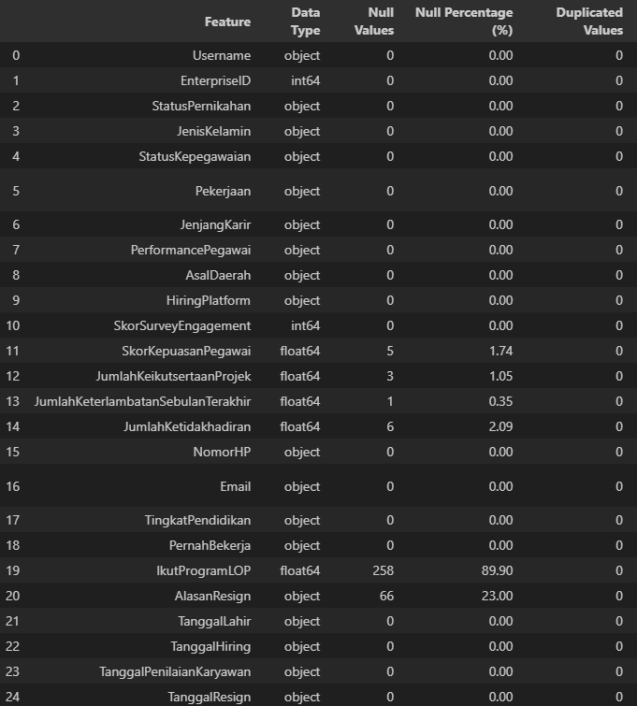
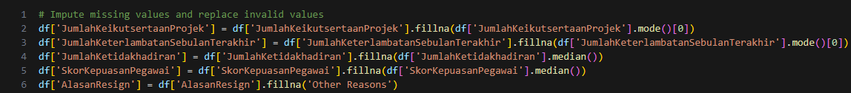
Data Cleaning & Preprocessing
Handling Duplicated and Missing Values
No duplicated values in this dataset.
There are 6 columns that missing values which are : SkorLepuasanPegawai, JumlahKeikutsertaanProjek, JumlahKeterlambatanSebulanTerakhir, JumlahKetidakhadiran, IkutProgramLOP, and AlasanResign.
We will handle them by imputation with median and mode values considering the distribution of the values and context (more explanation in code).

Slide 6
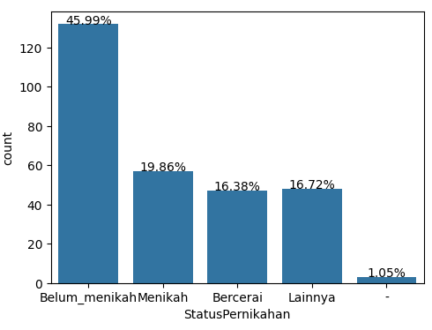
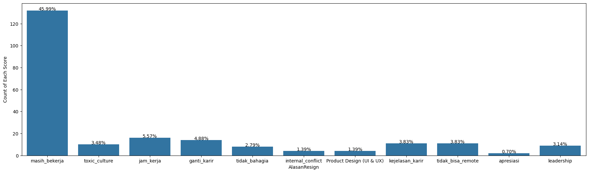
Data Cleaning & Preprocessing
Handling Out of Context Values
Some of the values in the dataset is out of context to what their columns should be. Columns that will be handled for this special case and the solutions are :
StatusPernikahan : Replace the value of ‘-’ to the mode.
AlasanResign : Replace the value of ‘Product Design (UI & UX)’ to ‘Oher Reasons’

Slide 7
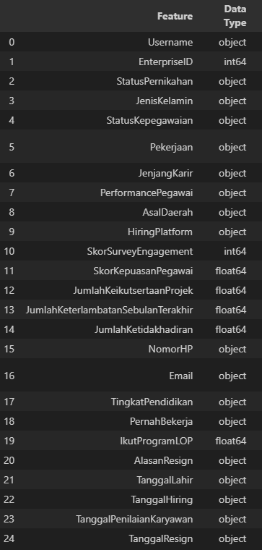
Data Cleaning & Preprocessing
Data Types Correction
Some columns have incorrect original datatypes which will be changed for better and correct result in further analysis.
Float to integer : SkorKepuasanPegawai, JumlahKeikutsertaanProjek, JumlahKeterlambatanSebulanTerakhir, JumlahKetidakhadiran
The values of these columns are discrete, so having float datatype might not actually make the code error, but it’s just give better context in analysis and visualization later.
String to datetime : TanggalLahir, TanggalHiring, TanggalPenilaianKaryawan, TanggalResign
Since we will need to extract datetime components, it’s better to convert the datatypesof these columns to datetime.

